Slide 1
P_mers
Move together, Work together
Develop solutions and approaches for addressing social and human issues.
28/05/22

Slide 2
INTRODUCTION
“Give a man a fish and you feed him for a day; teach a man to fish and you feed him for a lifetime.”
So we have made prototype which ensure a helping hand towards farmers, as these days uses of technologies in variety of fields has increased drastically which influences to make the best utilization out of it. We present you a “KRISHI SAHAYATA”, app that helps farmers to enhance their farm, cropping system in the best possible manner using the latest technologies present today.
This app will provides finest suggestion to grow their crops, based on the basics of the requirement that the farmer has input to the app.

Slide 3
User segment
Primary user are farmers for whom this program is introduced.
Farmers can also use our app to sell their yield.
Farming supply vendors will also use our application for selling their goods.
Students can also learn about different farming techniques, crops, etc.

Slide 4
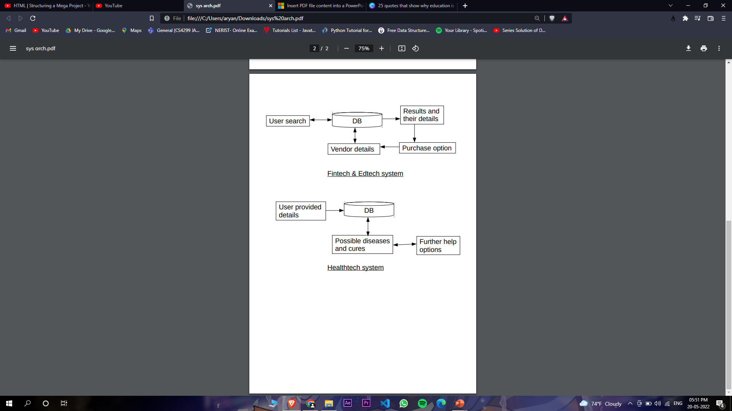
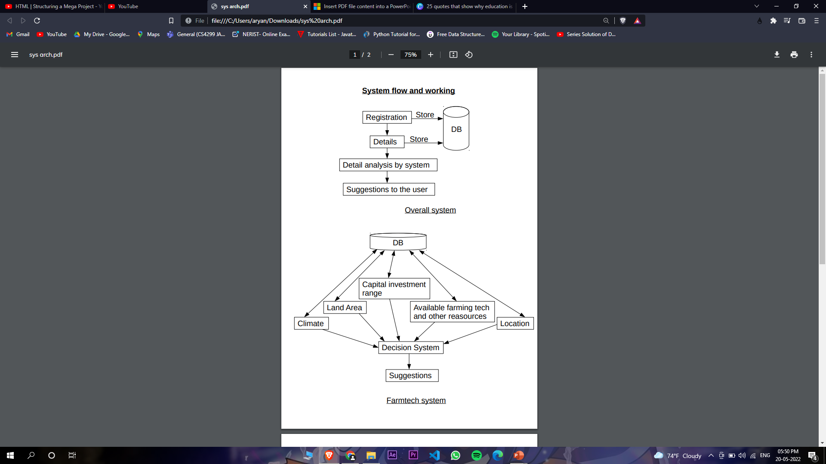
System architecture

Slide 5
Current Landscape
Currently there are only some govt. issued applications in this segment, which still does not uses the latest technology like AI and ML. We have planned to implement the most updated technologies that are available with Microsoft Azure to make it more productive for the end users.

Slide 6
Key Differentiators
1. Helps farmers with getting max profit and yield.
2. Provides healthy information of the crops to them.
3. Provides educational information about the crops.
4. Help the farmers in purchasing good and cheap seeds, pesticides, etc.
5. Connect vendors with the farmers.
6. Provide most viable farming solutions to the farmers, based on the details they provide, like climate, location, capital investment, etc.

Slide 7
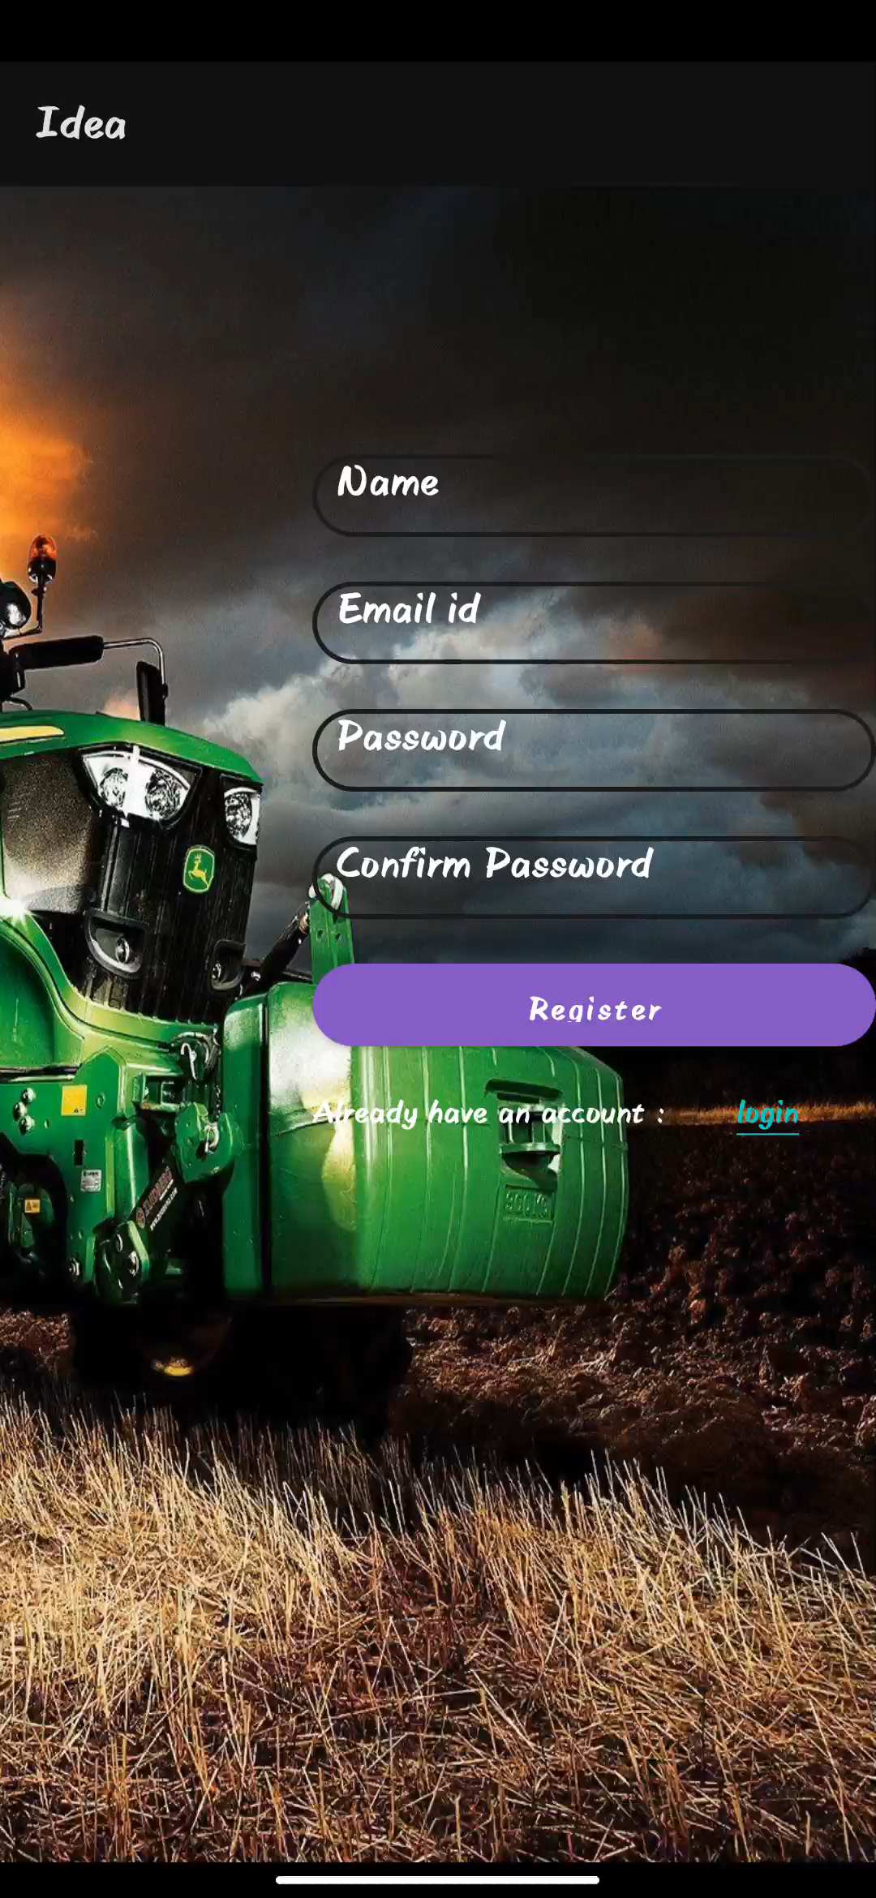
VIDEO

Slide 8
FUTURE VISION
Voice chat
The app currently uses only text based communication with the user but in future updates we are going to implement voice chat features in the application so that communication with the application is more realistic, fluent and without any inconvenience.
AI integration.
Currently the app will be using a QnA system to reply to any query that the user may have which will help them get the answers to most of the basic questions. But for longer and more complicated conversation we will be using ai and machine learning to get the user’s need and respond accordingly.

Slide 9
Thank You
Vivek Kumar Sah
Preyum Kumar
Sayan Das
Aryan Gupta

